Slide 1
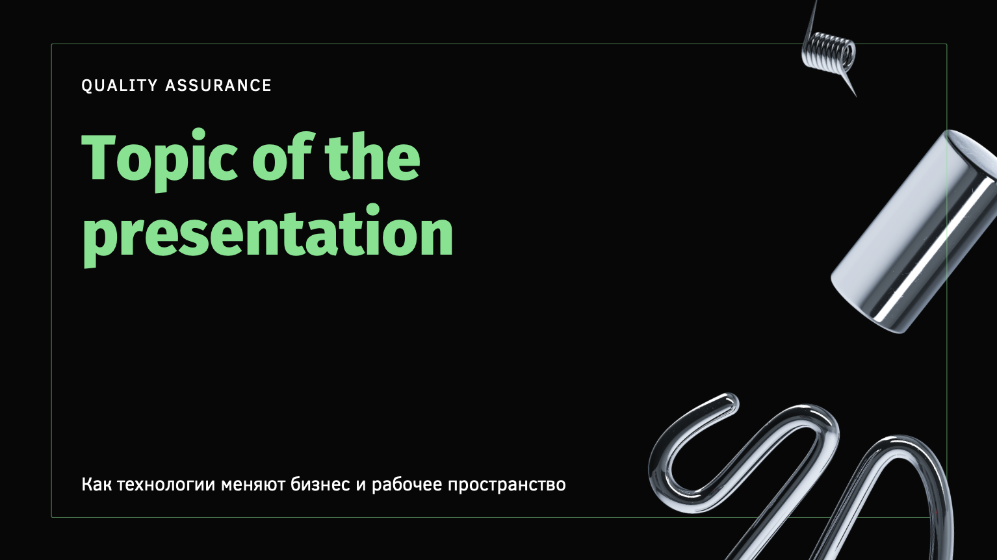
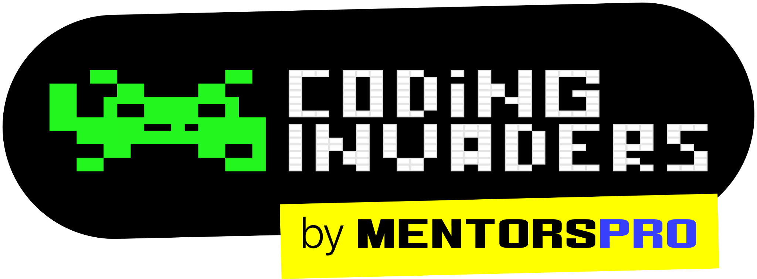
QA Automation Engineer
“Software Testing Introduction Session -2”
By: Manas
Content Title
Notes:
Title - Fira Sans, 50pt
Subtitle - Fira Sans, 16pt

Slide 2
Types of Testing
Smoke Testing
Sanity Testing
Installation Testing
Black box testing
White Box Testing
UAT Testing
Regression Testing
Performance Testing
Usability Testing

Slide 3
Smoke Testing
Smoke Testing confirms the basic functionality works for a product. Smoke Testing verify the stability of the build.
Validating the major functionality of the application.
Sanity Testing
Sanity testing is detailed testing of each functionality to ensure that product/software runs without any logical error.
Note: Sanity Testing is performed after Smoke Testing.

Slide 4
Difference Between Sanity Testing and Smoke Testing
Sanity Testing | Smoke Testing
Sanity testing is detailed testing of each functionality to ensure that product/software runs without any logical error. | Smoke Testing confirms the basic functionality works for a product.
This testing is performed by the testers | Smoke testing is performed by the developers or testers
The objective of the testing is to verify the “functionality” of the system in order to proceed with more rigorous testing | The objective of this testing is to verify the “stability” of the system in order to proceed with more rigorous testing
Sanity Testing is like specialized health check up | Smoke testing is like General Health Check Up

Slide 5
STLC (Software Testing Life Cycle) STLC is step by step process which are following to complete the testing activity in a project. There are 10 different phases in STLC 1. Test Initiation/QA Analysis 2. Test Plan 3. Identify the test scenario 4. Test case design 5. Test data preparation 6. Test case execution in testing environment 7. Defects (If Any) 8. Defect Retesting 9. Regression Testing 10 Testing Closure

Slide 6
STLC (Software Testing Life Cycle) is also called as…
End to End process of Testing
Testing Life Cycle
Manual Testing Life Cycle

